Slide 1
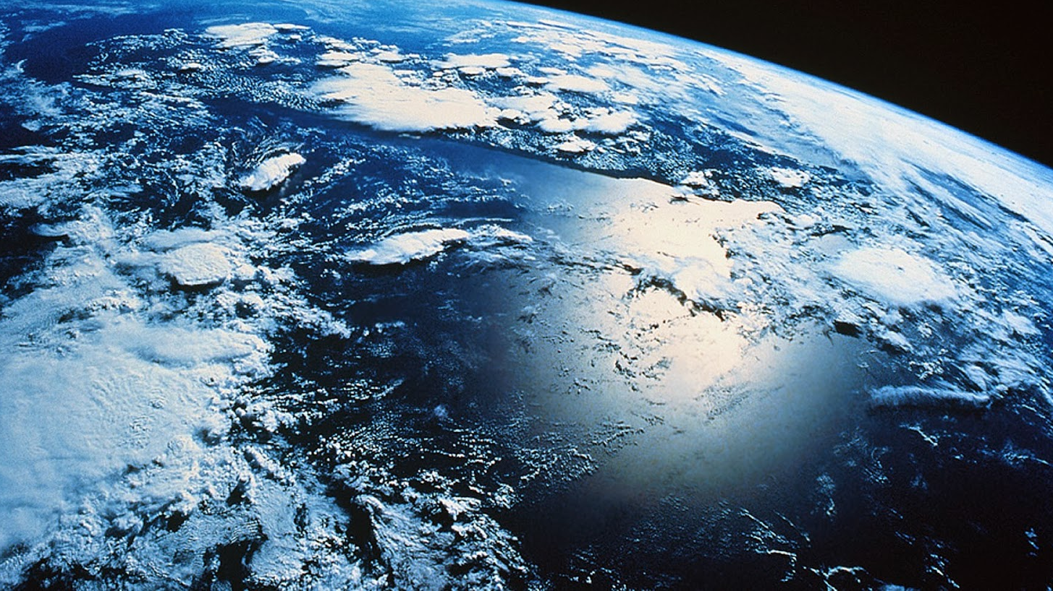
Climate Change, Climate Justice and Pro-Social Behavior: Bringing Real Change to CBS in the Face
of a World Crisis
Lisa W. Coyne, PhD Harvard Medical School/New England Center for OCD and Anxiety, Boston
This Photo by Unknown Author is licensed under CC BY-NC-ND
Notes:
Contextual behavior science, including evolutionary psychology, has roots that begin deep in the early 20th century in scientific and philosophical traditions. Since then, those roots have spread into every aspect of our contemporary world. At the same time, we have been presented with unprecedented challenges in the shape of the climate crisis, deep income disparities, and widening extremity across religion, politics, social class, sexual identity and gender, and nations. In a fraught and fragmented world, contextual behavioral science may have the potential to address these issues, although we must consider issues of size, scale, and scope of our interventions. This talk will discuss applications of contextual behavioral science, specifically, values discovery, in the context of its foundation in clinical RFT and with regard to its utility in creating an equitable, diverse, and nurturing world in which “all boats rise.”
We are the beginning of CBS – and now it’s time to move on – it is the end of the beginning of our organization
What will we do next?
What will we leave behind?

Slide 2
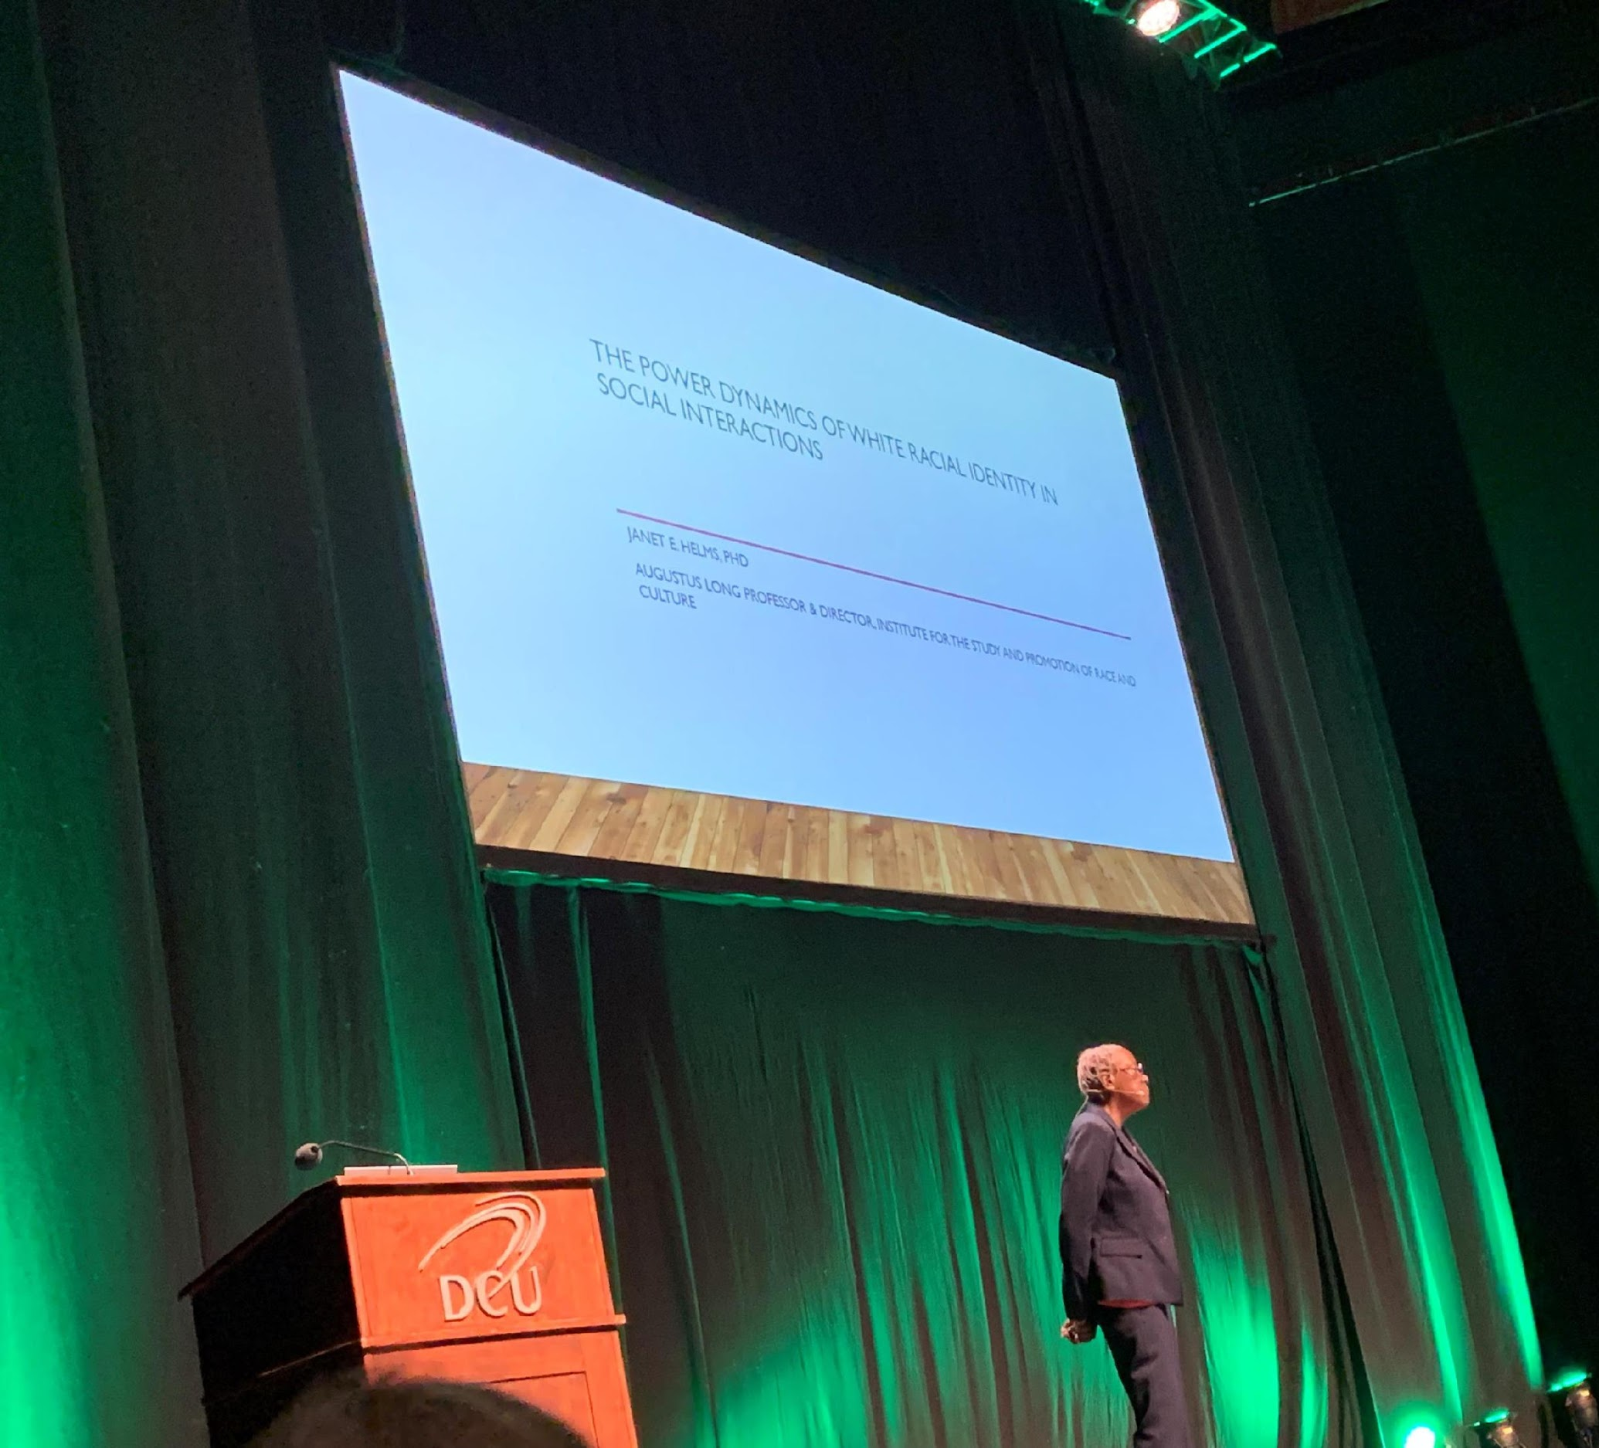
Dr. Janet Helms ACBS WorldCon Dublin, 2019
Climate change is going to make privileged people feel what those without privilege all around the world are feeling: what it is to be a marginalized person.

Slide 3
There is a way that nature speaks, that land speaks. Most of the time we are simply not patient enough, quiet enough, to pay attention to the story. --Linda Hogan, Chickasaw Nation Writer-in-Residence
Notes:
What is the story the world is trying to tell us?
“Story is a population level reinforcer” Starting with failure. story of opting out – no climate ride.
What is it the world is trying to tell us?

Slide 4
The story of a behavior problem...
...but maybe not the one you think

Slide 5
Sapiens: A Brief History of Humankind by Yuval Noah Harari
At one point there were 6 species of humans existing together on the planet
Homo sapiens destroyed them
Wherever humans have expanded, they have depleted the environment and moved on…over and over again
Notes:
Our languaging ability – our ability to tell stories – allowed us to plan ahead; to organize hunts; to avoid danger; to travel to resource rich environments; to create cultures that regulated the behavior of groups; to categorize into “us” and “them; ”to outwit our competitors – which, in Harari’s view, were other humans.
Yet we have allowed our language to divide us.

Slide 6
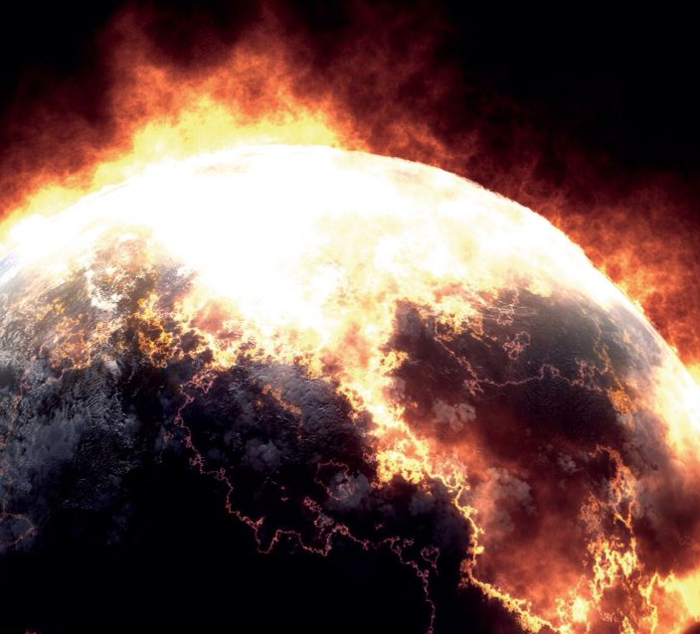
The human species is experiencing perhaps its most profound impasse: how to balance our technological and social evolution with the fragility of our planet and its resources.

Slide 7
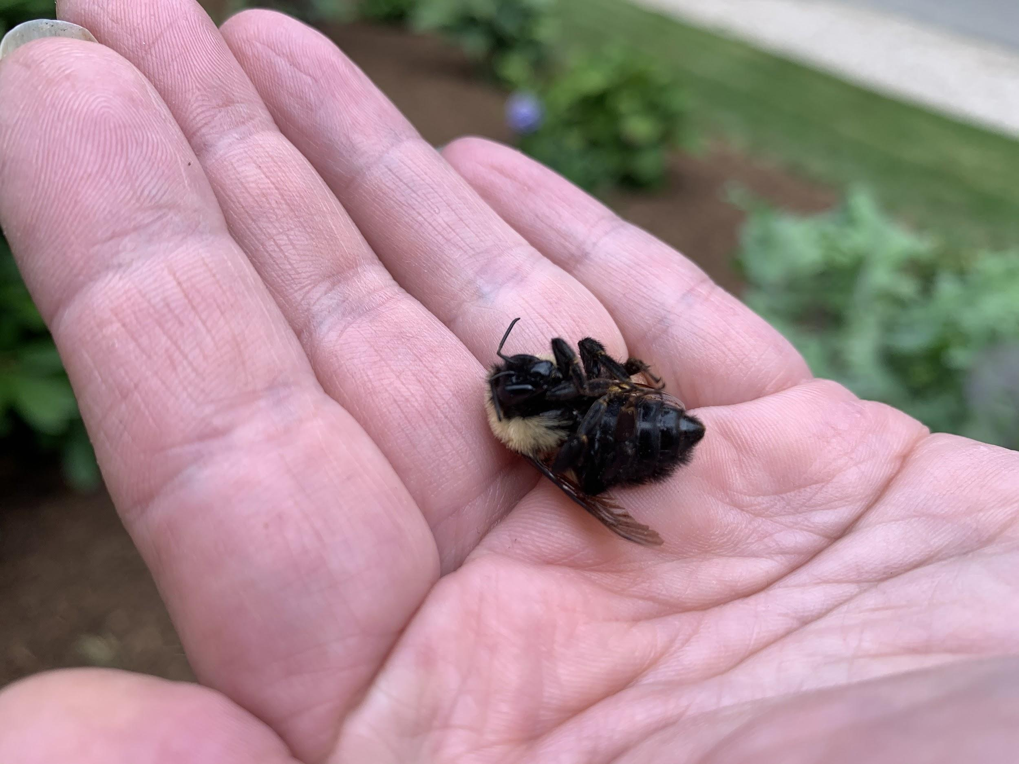
We are contributing to the 6th mass extinction.
Notes:
Effects of our overconsumption on biodiversity?
If you were alive in the year 1970, more than one in four birds in the U.S. and Canada has disappeared within your lifetime.
According to research published online in September by the journal Science, wild bird populations in the continental U.S. and Canada have declined by almost 30% since 1970.
More than 40% of insect species are declining and a third are endangered, the analysis found. The rate of extinction is eight times faster than that of mammals, birds and reptiles. The total mass of insects is falling by a precipitous 2.5% a year, according to the best data available, suggesting they could vanish within a century.
The planet is at the start of a sixth mass extinction in its history, with huge losses already reported in larger animals that are easier to study. But insects are by far the most varied and abundant animals, outweighing humanity by 17 times. They are “essential” for the proper functioning of all ecosystems, the researchers say, as food for other creatures, pollinators and recyclers of nutrients.

Slide 8
Climate Change Facts
Notes:
NASA has reported that carbon dioxide concentrations are 4012ppm, and rising
2016 was the warmest year on record
Carbon dioxide concentrations are 412ppm, and rising; 2016 hottest year on record’
The UN’s climate science body, the Intergovernmental Panel on Climate Change reported that the current trajectory puts the world’s emissions to overshoot the 2030 target for 1.5 degrees Celsius by 38 percent. The current pace of emissions would lead to as much as 3.2 degrees Celsius (5.7 degrees Fahrenheit) of warming by 2100. This would be a world where millions more people would have to abandon coastal areas due to rising sea levels and vastly more dangerous periods of extreme heat.
At the same time, the IPCC has also warned that the changes in the climate already underway are leading to unprecedented and irreversible shifts in lands, oceans, and the frozen parts of the planet, making them hostile to life.

Slide 9
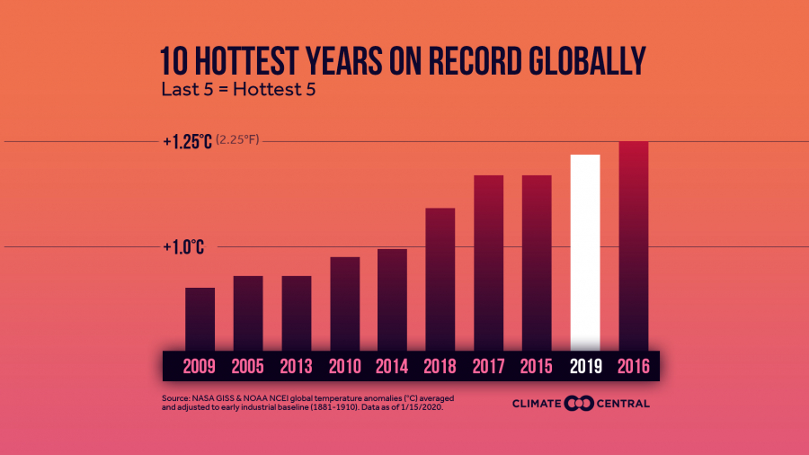
Notes:
NASA also found that 2010-2019 was the hottest decade ever recorded.
Parts of central Europe, Asia, Australia, southern Africa (including the island of Madagascar), New Zealand, Alaska, Mexico and eastern South America had record-high average land temperatures in 2019.
Both the Arctic and Antarctic oceans recorded their second-smallest average annual sea-ice coverage during the 1979–2019 period of record.

Slide 10
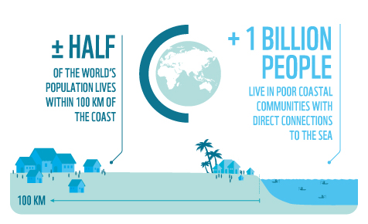
Notes:
As a result of heat-trapping pollution from human activities, rising sea levels could within three decades push chronic floods higher than land currently home to 300 million people
By 2100, areas now home to 200 million people could fall permanently below the high tide line
The new figures are the result of an improved global elevation dataset produced by Climate Central using machine learning, and revealing that coastal elevations are significantly lower than previously understood across wide areas
The threat is concentrated in coastal Asia and could have profound economic and political consequences within the lifetimes of people alive today
Findings are documented in a new peer-reviewed paper in the journal Nature Communications

Slide 11
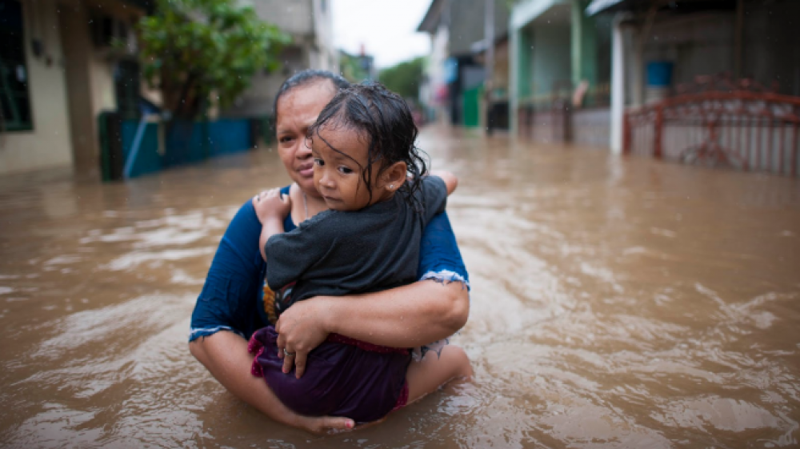
The effects of our collective behavior:
11 cities that will become
uninhabitable
by 2100
Notes:
Lagos, Bangladesh, New Delhi, Beijing, Shanghai, Jakarta, Abu Dhabi, Dubai, Chicago, Miami, New Orleans

Slide 12
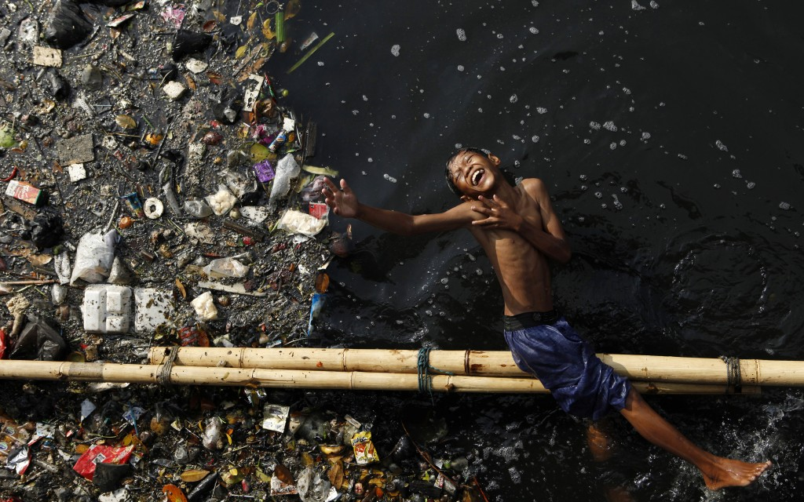
The countries that have contributed least to climate change, and are most vulnerable to extreme events, are projected to experience the strongest increase in variability. These changes would therefore amplify the inequality associated with the impacts of a changing climate.
Notes:
We believe everyone has a right to safe and affordable energy.
Unfortunately, energy companies and the energy industry do not operate under this principle. The way they do business not only impacts the environment but the people who live in it, which results in health problems and other issues for the African American community and communities who are low-income.
More African Americans live near coal fired power plants, nuclear power plants, or biomass (where waste is burned to make energy) power plants than any other demographic group in the U.S.
Over the past several decades, approximately 68% of African Americans live or have lived within 30 miles of a coal-fired power plant.
As a result, African Americans are more likely to suffer health problems from the pollution that these facilities produce.

Slide 13
We have a behavior problem.
Notes:
COVID has laid bare what it is.

Slide 14
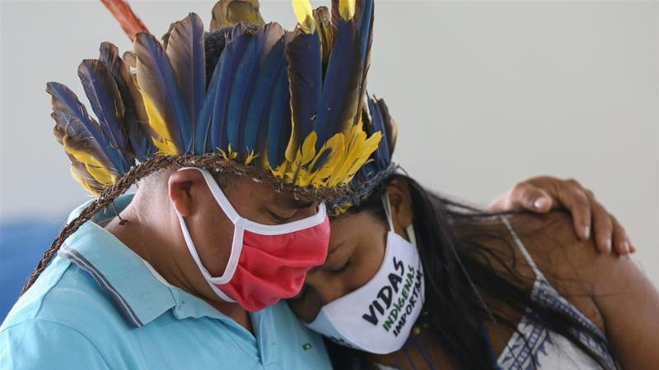
Notes:
Black and indigenous peoples all over the world are dying at much higher rates than more privileged groups https://www.brookings.edu/blog/up-front/2020/06/16/race-gaps-in-covid-19-deaths-are-even-bigger-than-they-appear/)
Long-standing racist policies and practices – such as residential segregation, unequal educational opportunities, and limited prospects for economic advancement – have led to increased vulnerability of Black people to climate change impacts and by extension other global crises that may emerge.
Examples: In Brazil, Dozens of Kokama were dying in what had become Brazil’s worst indigenous outbreak. But rather than alleviate the suffering, the government ignored them. Indigenous territories are frequently illegally invaded by gold miners, loggers and squatters. Deforestation has surged after years of falling. Cattle ranching in the forest has helped make Brazil the world’s largest beef exporter.
Those trends have accelerated under President Jair Bolsonaro, the far-right populist who wants to develop indigenous lands, whose size he calls “abusive,” and assimilate rather than preserve indigenous populations. https://www.washingtonpost.com/world/the_americas/coronavirus-brazil-amazon-indigenous-deaths-kokama-tikuna/2020/06/12/d4032bca-aa73-11ea-9063-e69bd6520940_story.html
In the U.S., Non-Hispanic American Indian or Alaska Native persons have a hospitalization and death rate approximately 5 times that of non-Hispanic white persons.

Slide 15
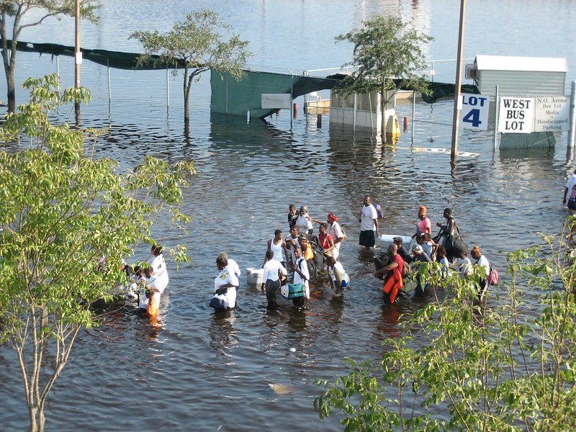
Notes:
Why is this? In the United States, disproportionate percentages of people of colour live in places that are polluted with toxic waste, leading to negative health effects such as cancer, asthma, degraded cardiac function and high blood pressure. Research has also highlighted that race has a stronger influence on exposure to pollutants than poverty.
According to Dr. Beverly Wright, CEO of the Deep South Center for Environmental Justice at Dillard University, communities of color:
Are more likely to breathe in polluted air. Communities of color breathe in 40 percent more polluted air than White communities across the US, according to the NAACP’s 2012 “Coal-Blooded” study. Fossil-fuel technology is directly to blame for some of this pollution. For example, a 2014 study out of the University of Minnesota confirmed that people of color in the US are 38 percent more likely to be exposed to the asthma-causing pollutant nitrogen oxide from climate-warming cars, construction equipment, and industrial sources like coal plants.
Are more likely to live near coal plants. Though African-Americans make up 13 percent of the US population, a startling 68 percent live within 30 miles of a coal-fired power plant, compared to 56 percent of Whites. This zone is where residents breathe the most resultant pollutants — which can cause a range of health problems, from heart attacks to birth defects to asthma, states the NAACP. Although Latinos make up 17 percent of the US population, 39 percent live within a 30-mile radius from a coal plant. Some Native American lands are home to large coal reserves, resulting in tribes across North America feeling the toxic effects from coal mines and plants.
Are more likely to live near toxic sites, including those housing waste from fossil-fuel infrastructure. For example, Dr. Bullard, a professor at Texas Southern University known as the “father of environmental justice” for his pioneering work in the field, points to the aftermath of the 2010 BP oil spill. When a BP underwater oil well burst in the Gulf of Mexico in 2010, it leaked a mind-boggling 94 to 184 million gallons of oil into Gulf. BP hired private contractors to clean up the oil-coated sand and refuse from the 120 miles of Gulf coastline the well had polluted.
Black communities are also disproportionately located in areas that are physically vulnerable to climate hazards, such as hurricanes and flooding. Moreover, they are often afforded unequal levels of protection from the government as compared to protection provided for other groups.

Slide 16
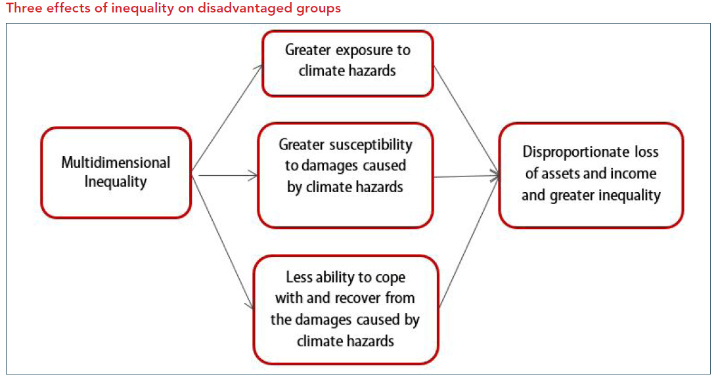

Slide 17
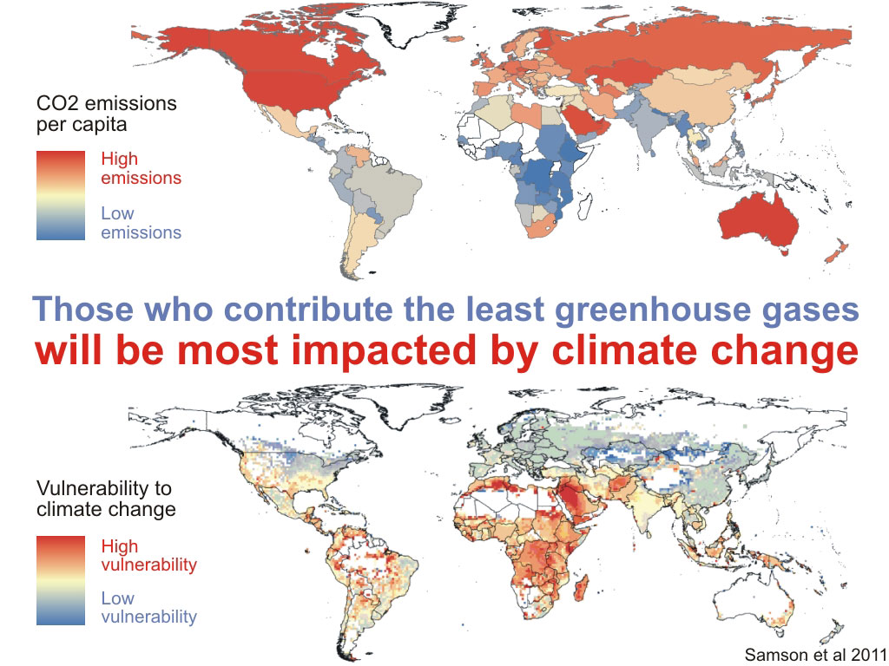
Notes:
Climate justice and racial justice are global issues.
https://climateanalytics.org/blog/2020/black-lives-matter-the-link-between-climate-change-and-racial-justice/

Slide 18
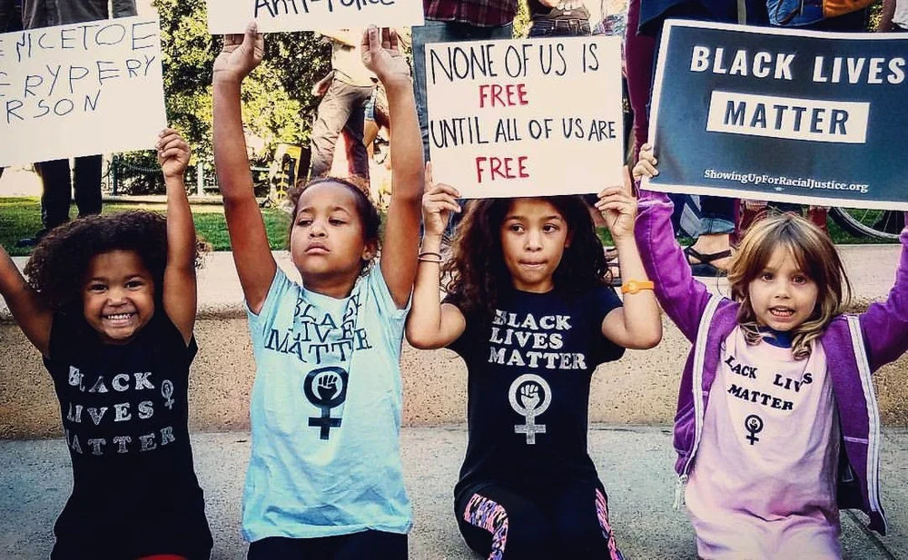
Notes:
As summed up by Patrisse Cullors and Nyeusi Nguvu, members of the Black Lives Matter movement, “Racism is endemic to global inequality. This means that those most affected – and killed – by climate change are Black and poor people”. It is for this reason that calls are now being made to centre racial equity and justice in seeking meaningful solutions for the climate crisis.
We “other” in two ways
From the natural world
From each other
Both can lead to catastrophic outcomes when we cannot see their collective impact and intersectionality

Slide 19
This story about “us and them” is wrong.
There is only one human family.
Notes:
In our story of us and them, we “other” in two ways
From each other
Both can lead to catastrophic outcomes when we cannot see their collective impact and intersectionality

Slide 20
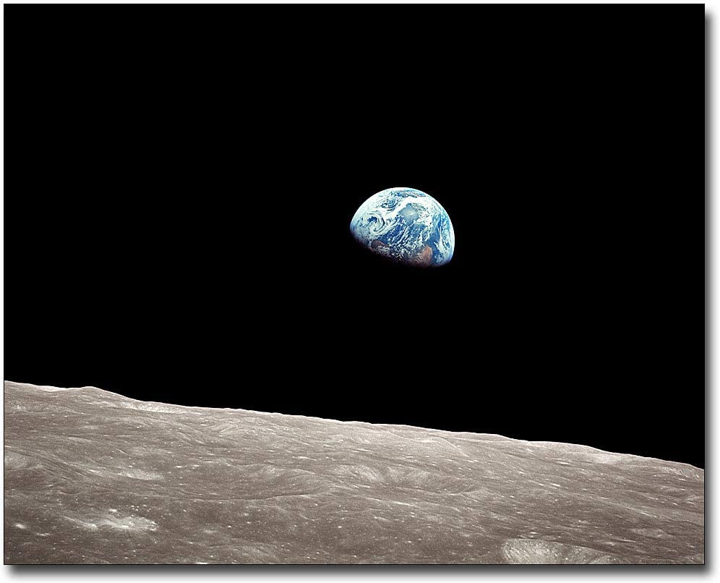
The story that there is an “us” and “the earth” is wrong.
We are one interdependent, global family.
Notes:
From the natural world

Slide 21
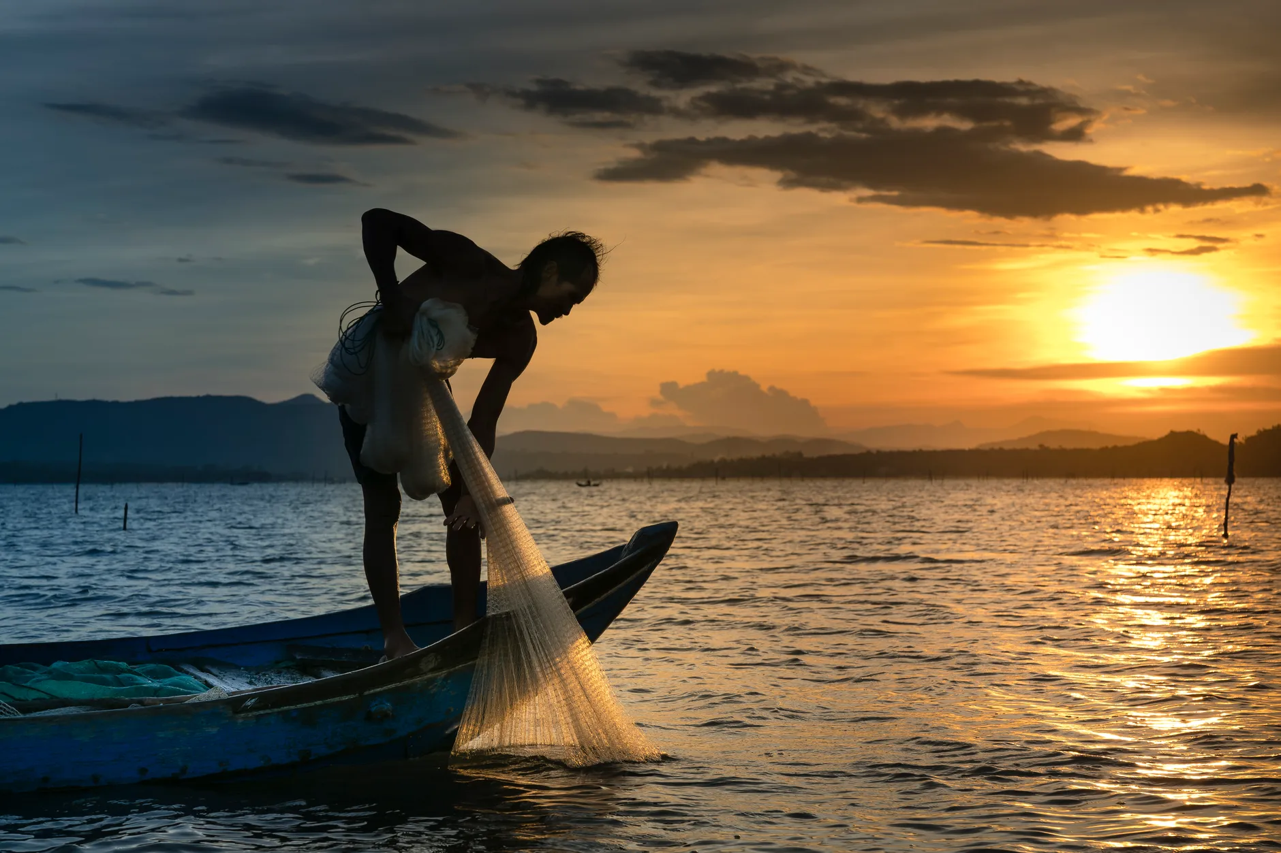
IPCC Report
https://climateanalytics.org/blog/2020/black-lives-matter-the-link-between-climate-change-and-racial-justice/
Caretaking is the utmost spiritual and physical responsibility of our time, and perhaps that stewardship is finally our place in the web of life, our work, the solution to the mystery that we are.
-Linda Hogan, A Spiritual History of the Living World
Notes:
2020 IPCC from the UN states: D.2.1. Climate change impacts and responses are closely linked to sustainable development which balances social well-being, economic prosperity and environmental protection. The United Nations Sustainable Development Goals (SDGs), adopted in 2015, provide an established framework for assessing the links between global warming of 1.5°C or 2°C and development goals that include poverty eradication, reducing inequalities, and climate action. (high confidence) {Cross-Chapter Box 4 in Chapter 1, 1.4, 5.1}
D.2.2. The consideration of ethics and equity can help address the uneven distribution of adverse impacts associated with 1.5°C and higher levels of global warming, as well as those from mitigation and adaptation, particularly for poor and disadvantaged populations, in all societies (high confidence). {1.1.1, 1.1.2, 1.4.3, 2.5.3, 3.4.10, 5.1, 5.2, 5.3. 5.4, Cross-Chapter Box 4 in Chapter 1, Cross-Chapter Boxes 6 and 8 in Chapter 3, and Cross-Chapter Box 12 in Chapter 5}
D.3.1. Adaptation options that reduce the vulnerability of human and natural systems have many synergies with sustainable development, if well managed, such as ensuring food and water security, reducing disaster risks, improving health conditions, maintaining ecosystem services and reducing poverty and inequality (high confidence). Increasing investment in physical and social infrastructure is a key enabling condition to enhance the resilience and the adaptive capacities of societies.
D.3.2. Adaptation to 1.5°C global warming can also result in trade-offs or maladaptations with adverse impacts for sustainable development. For example, if poorly designed or implemented, adaptation projects in a range of sectors can increase greenhouse gas emissions and water use, increase gender and social inequality, undermine health conditions, and encroach on natural ecosystems (high confidence). These trade-offs can be reduced by adaptations that include attention to poverty and sustainable development

Slide 22
ACBS is dedicated to the alleviation of human suffering and the advancement of human well-being through research and practice grounded in contextual behavioral science.
Our Organizational Vision
Notes:
Here is where targeted othering can be helpful - how do we capitalize on our diversity to share resources, and to send help where it is most needed, to identify who can help us when we need etc.

Slide 23
The End of the Beginning: It’s Time for ACBS
to Evolve
“…the knowledge that behavioral scientists have accumulated about human behavior, coupled with scientific methods, can enable our societies to achieve unprecedented advances in human well-being.”
Notes:
We are the beginning of CBS – and now it’s time to move on – it is the end of the beginning of our organization
What will we do next?
What will we leave behind?

Slide 24
If we act as one
We will leave our children a more just, collaborative, sustainable, nurturing world.

Slide 25
What if we already have technologies that will help us scale up behavior change to a global level?

Slide 26
Evolutionary Theory ‘Adaptable to change’

Slide 27
Identify the ‘Adaptive Challenge’
A challenge for which there remay be no ready-made technical answer
It requires the gap between values, beliefs, attitudes and behaviors to be addressed
Notes:
WORKSHOP ACTIVITY 2
Now we have created a bit of space, we have shifted our perspective, it might be easier to identify an ‘adaptive challenge’.
Remember that an adaptive challenge is ‘a challenge for which there is no ready-made technical answer (mechanistic view of the world doesn’t always work)’
It is a challenge requires the gap between values, beliefs, attitudes and behaviours to be addressed
We have outlined just some of ours – us v them, using up our resources, overconsumption without regeneration and conservation
I would invite you to consider an adaptive challenge in your work that requires people to shift their ideas or behaviour. In our experience people are usually quite clear about what the challenges are. If not though, here are some ideas ....

Slide 28
Questions We Can Ask Ourselves
What challenges are we facing?
How do I want things to be?
How are they now?
Where are the people (including me?), and
How must people change if this gap is to be closed?
Notes:
We suggest you start by compiling a list of challenges you are facing. We define what the problem is, and if there is a technical, or mechanical solutions, then remove that challenge, which leaves the adaptive.

Slide 29
I don’t know how to explain to someone why they should care about other people.
-Lauren Morrill

Slide 30
Nurturing Prosocial Communities
The act of getting along with and cooperating with others
The Prosocial process can help groups create a sense of “us”
It can improve cooperation by helping balance self-interest with the interests of the group
Engagement in the process can build a more strongly shared identity, greater engagement in purpose, better relationships, and improved performance
Prosocial is based on 8 “core design principles” that characterize successful groups

Slide 31
WHAT IF...CBS could address climate change
and social justice
by creating a nurturing and equitable world?
Minimize biologically and psychologically toxic events
Teach, promote, and reinforce prosocial behavior, including self-regulatory behavior
Monitor and limit problem behavior
They foster psychological flexibility to support engagement in valued behavior
Notes:
Prosocial behavior (Wilson, 2009) – “I think it is important to help other people” and “I am sensitive to the needs and feelings of others” – this predicted differences in how they would solve problems
Kids low on prosociality experienced more stressful events

Slide 32
Aspirations for ACBS as a Whole
We can promote solutions on a public health scale – especially with regard to reducing disparities
We can make organizational commitments, such as hosting “no-fly” conferences, or striving to become a carbon-neutral organization
We can collaborate with other organizations to foster interdisciplinary solutions

Slide 33
What if nurturing prosocial behavior and collaboration in groups could lead to global change?

Slide 34
References
Biglan, A., Flay, B. R., Embry, D. D., and Sandler, I.N (2012). The critical role of nurturing environments for promoting human wellbeing. American Psychologist, 67(4): 257–271.
Hayes, S. C., Sanford, B. T., & Chin, F. T. (2017). Carrying the baton: Evolution science and a contextual behavioral analysis of language and cognition. Journal of Contextual Behavioral Science, 6(3), 314-328.
Sloan Wilson, David (2020) This View of Life
Wilson, K. G., Hayes, S. C. & Biglan, A. (2018). Evolution and Contextual Behavioral Science: An Integrated Framework for Understanding, Predicting, and Influencing Human Behavior. New York: Guilford.

